Slide 1
Comp 400:
Prioritizing smt bug reports by learning from historical patches
By: Adam Weiss

Slide 2
Abstract
SMT solvers
Widely used

Slide 3
Abstract
SMT solvers
Widely used
Project Yin Yang
Fuzzing

Slide 4
Abstract
SMT solvers
Widely used
Project Yin Yang
Fuzzing
Too many bug reports = annoying

Slide 5
Solution!
ML system to categorize bug reports!

Slide 6
Where does my data come from
Z3 and CVC4 are open source
Github!
Project Yin-Yang

Slide 7
Where does my data come from
Z3 and CVC4 are open source
Github!
Project Yin-Yang
REST API
Cleanup duplicates etc.

Slide 8
Machine Learning
Supervised system

Slide 9
Machine Learning
Supervised system
Must produce categories myself
Too time consuming to do by hand

Slide 10
Heuristic
How old is the bug ?
Has it been marked as won’t be touched?

Slide 11
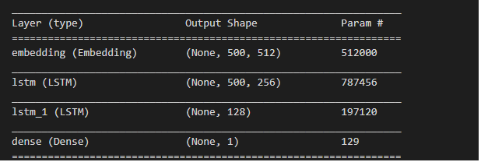
Analyzing reports (phase 1)
LSTM

Slide 12
Analyzing the analysis
Validation accuracy: 70-75%
Ex:
.7548 validation vs .7216 training

Slide 13



Success
Higher validation accuracy than training means a good model w/o overfitting

Slide 14
Where to go From here
Incorporate program details!

Slide 15
How?
Source code is too huge

Slide 16
How?
Source code is too huge
Logging!

Slide 17
How to log
Compile with clang and run an instrumentation pass
fxray

Slide 18
Fxray
Sounds good – doesn’t work
Never makes a log in Z3
CVC4: too complicated to incorporate

Slide 19
From here on out Z3 only
CVC4 has a very complex build system

Slide 20

How do we move forward
Write our own logging system as a clang pass

Slide 21
Big idea
Log every function call

Slide 22
A little while later…
Huge log files
Many kb for no input
> 15 minute runtime, >1.7GB file for 2+2=4

Slide 23
How do we deal?
Log only above a certain level
BFS

Slide 24
Any issues
Garbage data
Name matching

Slide 25
Any issues
Garbage data
Easy to strip out llvm debug
Easy to run through c++filt
Name matching
LLVM pass function names and executable function names are different
Harder – fuzzy match

Slide 26

How to collect data

Slide 27
Cant use different versions
Impractically slow build process
Different build processes

Slide 28
solution
Use a version from before the bug reports
June 2019

Slide 29
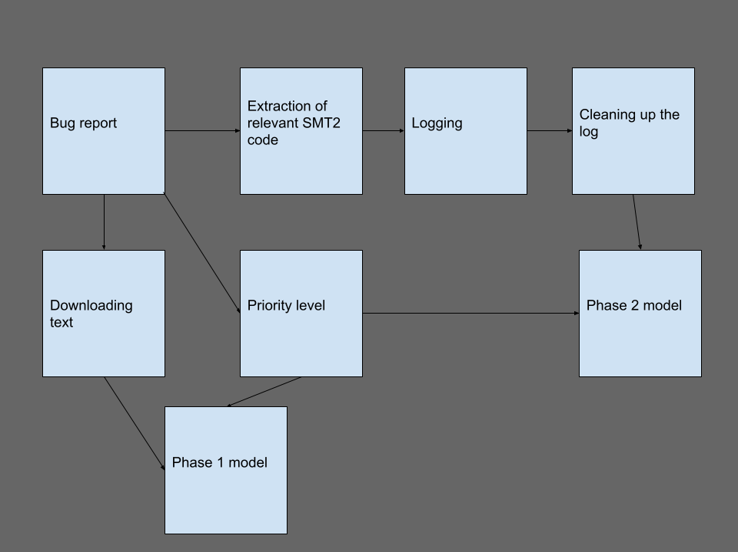

Slide 30
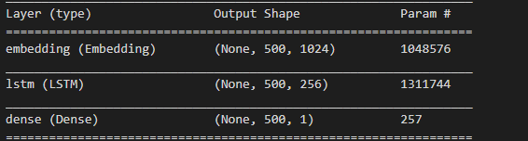
Phase 2 model
Based on phase 1 model

Slide 31
Performance
45 -55 %

Slide 32
Performance
45 -55 %
Much lower than before

Slide 33
Fit quality
17 training – 43 validation
01
54 training – 45 validation
02

Slide 34
Fit quality
17 training – 43 validation
01
54 training – 45 validation
02
Much bigger embedding layer
Seen in picture

Slide 35
Why is this
Small amounts of data
Needing more pre-processing

Slide 36
Why is this
Small amounts of data
Only 30 samples out of several hundred
Needing more pre-processing
Theoretical

Slide 37

Where to go from here?
Future work!

Slide 38
Future ideas
Integrating bug report heuristics
Function call depths
Tighter name matching
Random logging
Memory error
CVC4
Changed heuristic
Other bugs
Integration of models
Comparison
Richer categories

Slide 39
Integrating bug report heuristics
More info in bug reports
Activity levels
Responses

Slide 40
Function call depths
Tune this value

Slide 41
Tighter name matching
Look into fixing the name matching for better logging

Slide 42
Random logging
Maybe get more interesting samples without being huge

Slide 43
Memory error
A memory error prevented data from being generated adequately

Slide 44
CVC4
Instrument CVC4 for more data

Slide 45
Classification Heuristic
The heuristic is rather arbitrary
No evidence indicating it’s the best

Slide 46
Expanding to other bugs
Very small subset of bugs
Challenging
Specific format

Slide 47
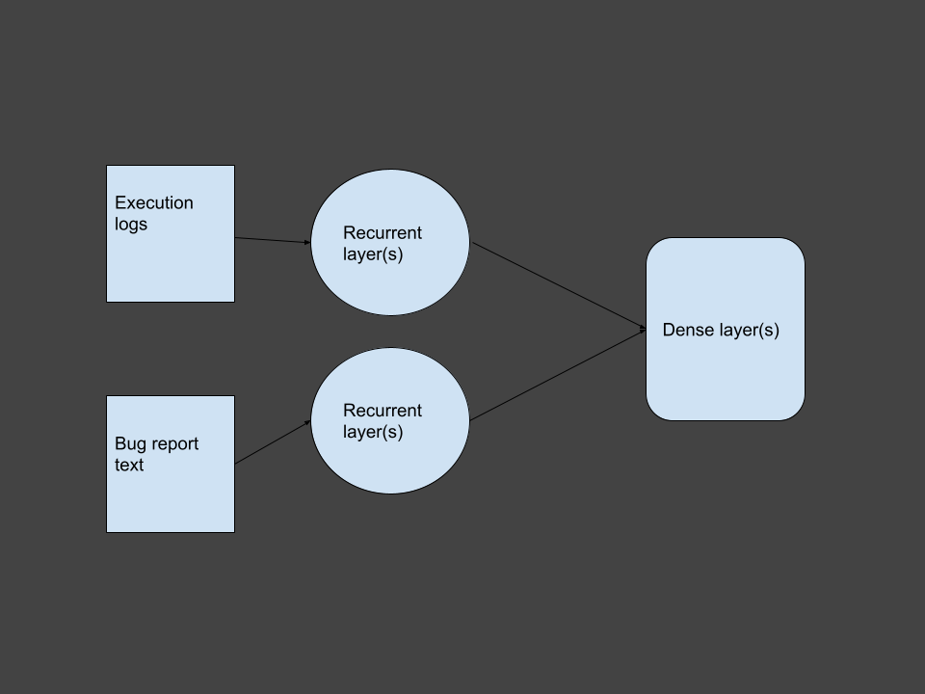
Integration of models

Slide 48
Comparison of phase 1 and 2 models
Are the bugs they classify the same

Slide 49
Richer categories
How do we classify bugs
Not Binary!
Many categories
Would require architecture changes
New loss function – multi-category cross entropy

Slide 50

Thank you
Thank you for listening!
Thank you for supervising this project!

Slide 51
Citations
See report

